Slide 1
Category review: Chips
Feb 2026
Retail Analytics
Brand note: If client logo is not required, use alternate title page layout right click slide thumbnail > Layout > Title

Slide 2
Notes:
To view Privacy video explaining how important data privacy is to Quantium, please click here: https://www.youtube.com/watch?v=Zq1QDAkoRzU
or here Q:\Company Reference\Brand & Design\Brand videos\Q Privacy.mp4
At Quantium, we believe that data is the behavioural footprint of humanity and that it has to be treated with the utmost care and responsibility.
Histories, attitudes, indeed lives are stored within it in ways that aren’t always apparent – and that’s what makes its potential so powerful.
To work with it responsibly, sensitively, we set ourselves the highest data privacy protection and governance standards.
We have spent 17 years perfecting privacy-by-design and secure-by-design principles. Central to this is not holding any personally identifiable information about people –
we neither receive it, and put the necessary protections in place to be unable to decipher it.
Every aspect of handling data is safeguarded: from its de-identification, to its encryption – data security is paramount and of the highest grade.
We pride ourselves on gaining the trust of iconic organisations around the world through years of securely working with their data,
and in turn the trust that builds with their stakeholders.

Slide 3
Executive summary
01
Task 1
The sales of chips were observed increase until some couple of days before Christmas. This can be considerd great chance to capitalize this momentum with special offers and discounts.
The main Stream young single\couples were observed contributing more to the sales of chips.
Older Families & Young Families were found to purchase more chips compared to other life stages.
02
Task 2
Control store of 233,155 & 237 were choosen for trial store 77,86 & 88 in order to replicate previous performance.
During the trial period, the stores 77 & 88 differed considerably from control store in term of both sales and customer Count.
However, the increase in trial store 88 was not substantial compared to control store.

Slide 4
01
Category

Slide 5
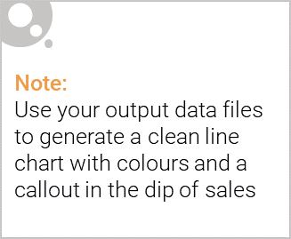
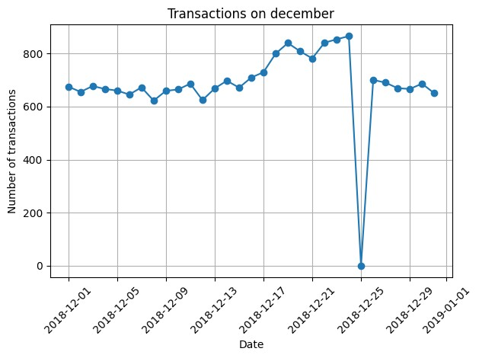
The Transactions of chips gradually grew as the christmas approached. The dip on 25th dec indicates the stores remained close on Christmas. The transactions slowly started to decline after Christmas.

Slide 6

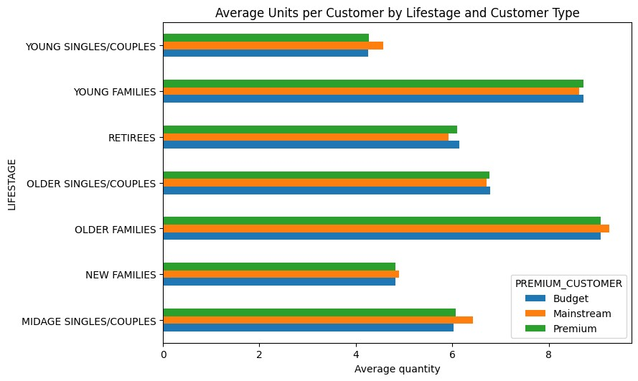
Older and younger families are the customers that make the largest average transactional purchase.

Slide 7
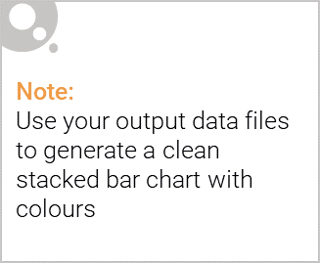
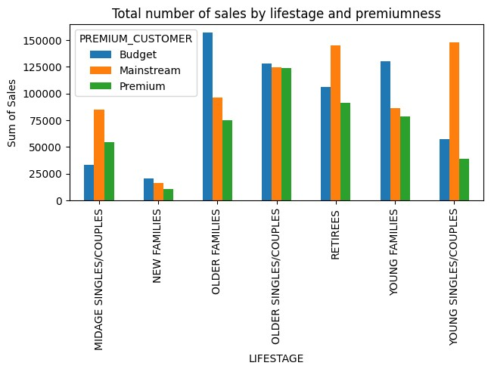
Editable (delete this)
While majority of mainstream young\single couples and mainstream retirees contribute to total number of sales, budget older & Younger families also are valuable customers in term of sales.

Slide 8
02
Trial store performance

Slide 9
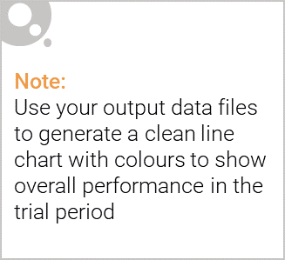
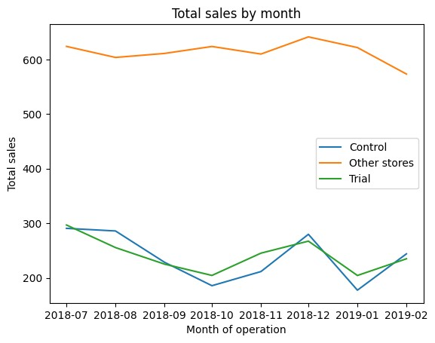
The trial store’s performance in term of total sales and customers count were reflected in control stores, but not displayed in the other stores.

Slide 10
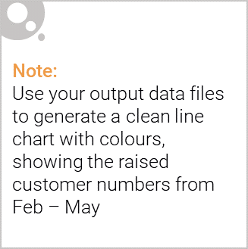
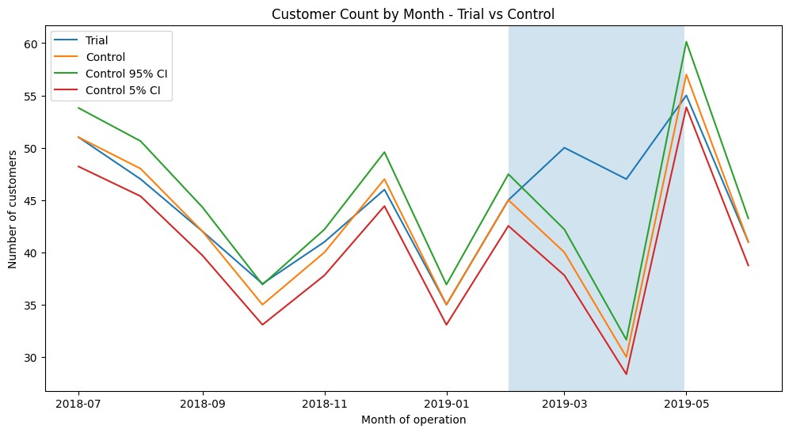
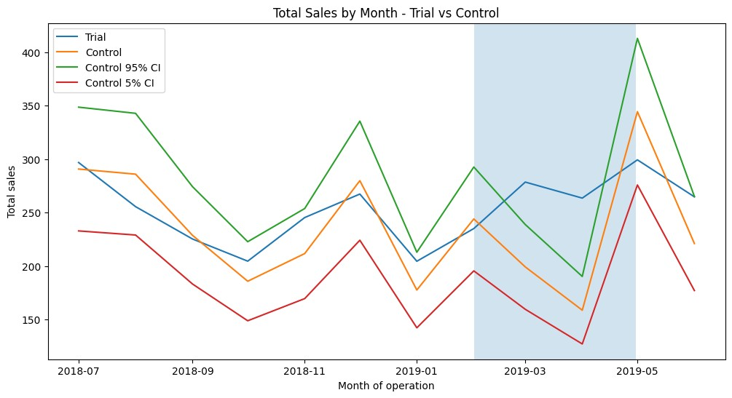
Trial Store 77 & Control Store 233
Trial period (Feb–Apr), Sales/customers increased significantly & After trial numbers revert, indicating the effect was driven by the trial itself, not seasonal trends

Slide 11
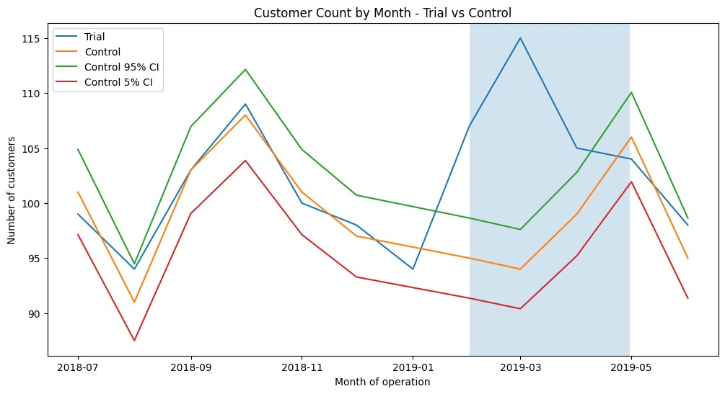
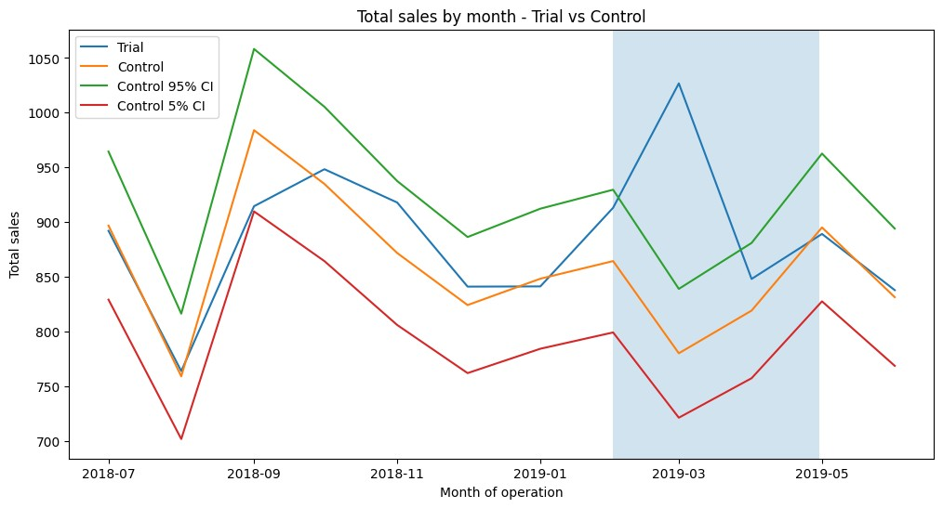
Trial Store 86 & Control Store 155
The trial store behaves relative to the scaled control store + confidence intervals, there is a clear and significant uplift during the trial period (Feb–Apr 2019) for store 86 compared to its matched control store 155.

Slide 12
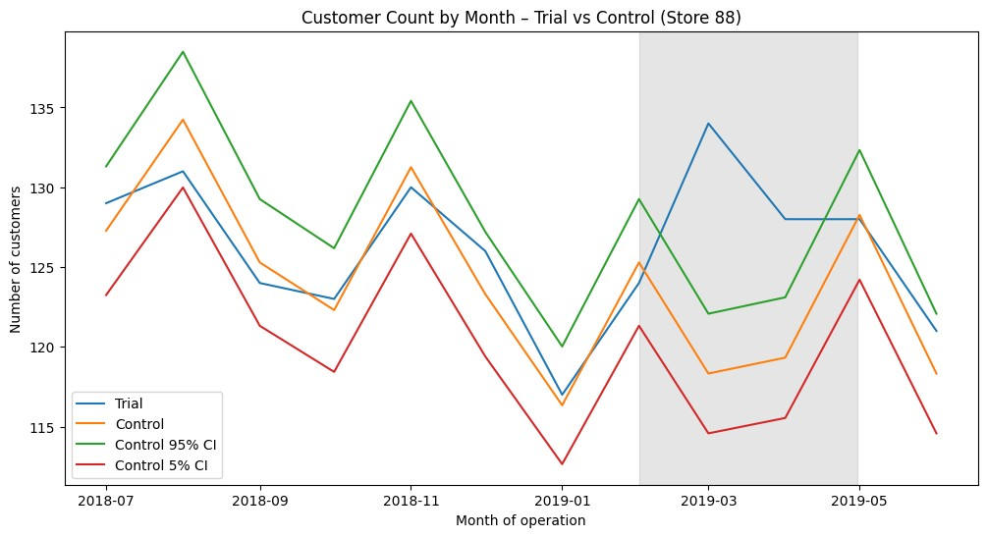
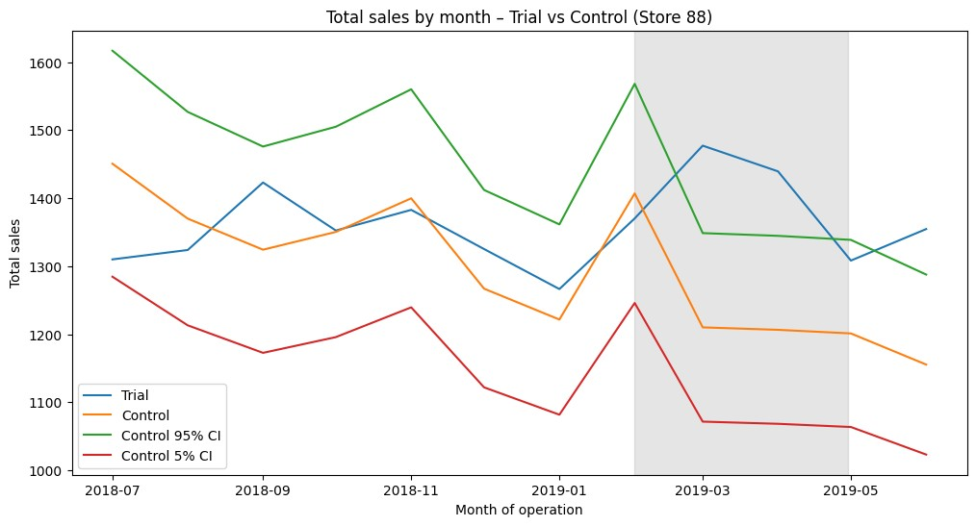
Trial Store 88 & Control Store 237
Total number of customers in the trial period for the trial store is significantly higher than the control store for initial two out of three months however for sales it is final two out of three month.

